Slide 1
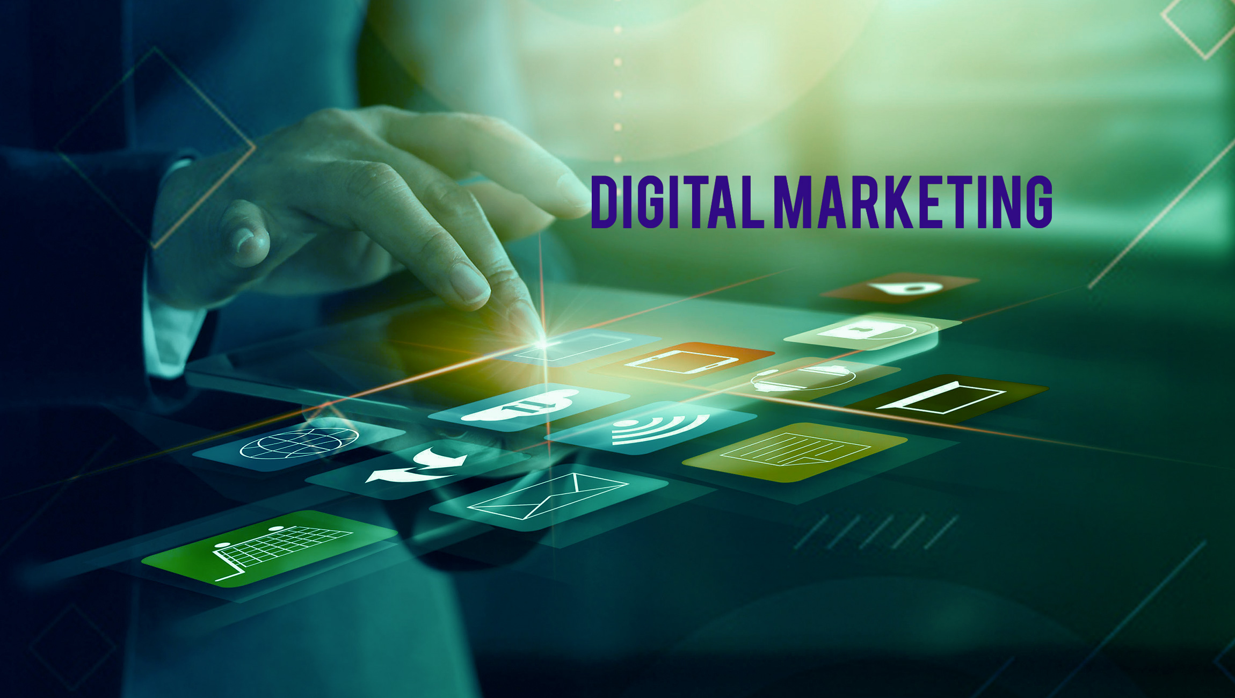

Slide 2
DIGITAL MARKETING
Digital marketing is defined as a
“marketing approach that primarily relies on the internet to connect with the target audience through various digital media channels and platforms”
A new way of approaching customers and new ways of understanding how customers behave compared to traditional marketing.
Examples of digital marketing include things like websites, social media mentions, YouTube videos, and banner ads. Specifically, digital marketing is similar to traditional advertising, but using digital devices

Slide 3
Differences between traditional and digital marketing
Traditional Marketing | Digital Marketing
1. Communication is unidirectional in traditional marketing, which means, an organization communicates about its services with its audiences. | 1. Communication is bidirectional in Digital Marketing as businesses can communicate with customers and customers can ask queries or make suggestions to businesses as well.
2. Medium of communication in traditional marketing is generally phone calls, emails, and letters. | 2. Medium of communication is more powerful and involves social media websites, chats, apps and Email.
3. Campaign in Traditional marketing takes more time as designing, preparing, and launching are involved. | 3. Digital marketing campaigns can be developed quite rapidly and with digital tools, channelizing Digital Marketing campaigns is easier.
4. It is best for reaching local audience. | 4. It is very effective for reaching global audiences.
5. It is almost impossible to measure the effectiveness of a traditional marketing campaign. | 5. Digital Marketing lets you measure the effectiveness of a digital marketing campaign through analytics.

Slide 4
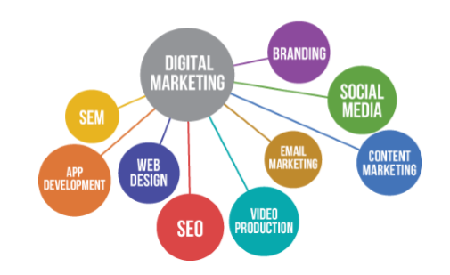
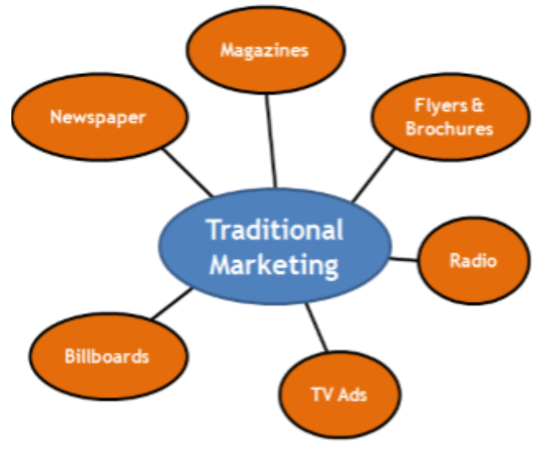

Slide 5
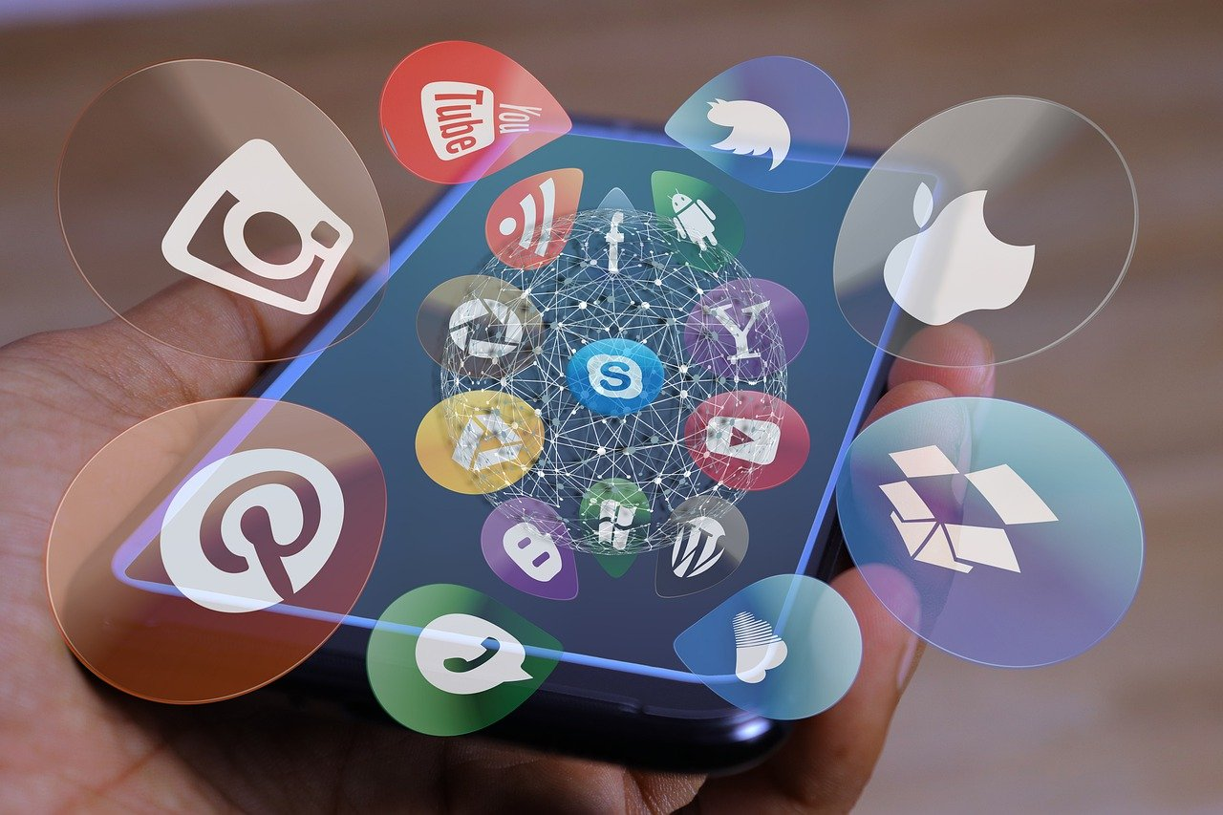
DIGITAL MARKETING LANDSCAPE

Slide 6
DEFINITION
The digital marketing landscape refers to the various channels, platforms, and marketing strategies that constitute the domain of digital marketing.
To navigate this rapidly evolving field, it's important to understand the fundamental components that make up this landscape
Websites: A website is often the cornerstone of a company's online presence, serving as a virtual storefront, information hub, and a primary point of interaction with customers.
Websites help establish credibility, offer vital information, and generate leads and conversions.
Social Media: Platforms such as Facebook, Instagram, Twitter, and LinkedIn offer unique ways to engage with target audiences, build brand awareness, and drive conversions.
Social media platforms facilitate user-generated content, online communities, and genuine engagement, which can lead to increased brand awareness and trust.

Slide 7
Email Marketing: A cost-effective way to reach customers directly in their inbox, email marketing allows businesses to send newsletters, promotions, and personalized messages.
Email marketing strengthens customer relationships and facilitates effective communication.
Search Engine Optimization (SEO): By optimizing website content and following best practices, businesses can improve their search engine rankings and attract more organic traffic.
SEO increases online visibility, driving organic traffic and potentially improving conversion rates.
Mobile Marketing: With the majority of people accessing the internet via mobile devices, creating mobile-responsive websites, apps, and advertising campaigns is essential for reaching audiences on the go.
Mobile marketing ensures that businesses can reach their audience on their preferred devices, providing a seamless user experience.

Slide 8
Pay-Per-Click (PPC) Advertising – PPC advertising is a subset of digital advertising where companies place ads with a third-party website to drive online traffic. But unlike other forms of advertising, companies only pay for PPC advertising when a user clicks on the link.

Slide 9
steps on how to create a digital marketing strategy
Define your goals.
What do you want to achieve with your digital marketing strategy? Do you want to increase website traffic, generate leads, or drive sales? Once you know your goals, you can start to develop a strategy to achieve them.
2. Identify your target audience.
Who are you trying to reach with your digital marketing efforts? What are their demographics, interests, and pain points? Once you know your target audience, you can tailor your content and messaging to appeal to them.
3. Choose the right channels.
Which digital channels will you use to reach your target audience? Consider factors such as their age, interests, and where they spend their time online.
4. Create engaging content.
Your content should be informative, relevant, and engaging. It should also be optimized for search engines.
5. Track your results.
It's important to track your results so you can see what's working and what's not. This will help you make adjustments to your strategy as needed.

Slide 10
Here is an example of a digital marketing strategy:
Goal: Increase website traffic by 20% in the next quarter.
Target audience: Men and women ages 25-45 who are interested in fitness.
Channels: Website, social media (Facebook, Instagram, Twitter), email marketing.
Content: Blog posts, infographics, videos, social media posts, email newsletters.
Tracking: Google Analytics, social media analytics, email marketing analytics.
This is just an example, and your digital marketing strategy will need to be tailored to your specific business and goals.
However, following these steps will help you create a successful digital marketing strategy that will help you achieve your goals.

Slide 11
FACTS
The average salary for a Digital Marketing Manager is Rs 840,000 in 2023.
Means 70,000 Rs Per month
Rs 416.50 (Avg. Hourly Rate)
Average freelance digital marketing salary in Pakistan is minimum 1 Lac per month
The average freelance digital marketing salary in the USA is $78,000 per year or $37.50 per hour.
Entry level positions start at $48,750 per year while most experienced workers make up to $87,575 per year.

Slide 12
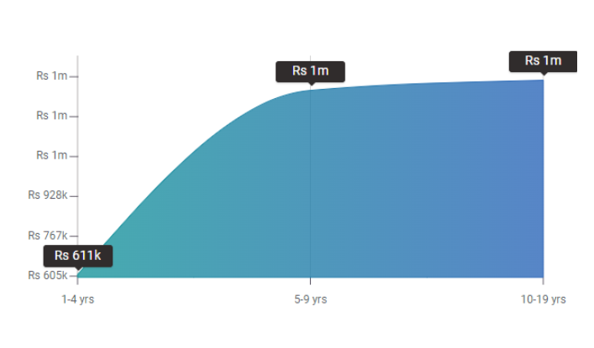
What is the Pay by Experience Level for Digital Marketing Managers?
An early career Digital Marketing Manager with 1-4 years of experience earns an average total compensation (includes tips, bonus, and overtime pay) of Rs 610,852.
A mid-career Digital Marketing Manager with 5-9 years of experience earns an average total compensation of Rs 1,358,824.
An experienced Digital Marketing Manager with 10-19 years of experience earns an average total compensation of Rs 1,400,000.

Slide 13






EXAMPLES IN PAKISTAN

Slide 14





EXAMPLES AROUND THE WORLD

Slide 15
CAREER BASED ON DIGITAL MARKETING
Online Content Developer
Social Media Marketing
Search Engine Optimization Specialist
Business Analytics Specialist
Brand Management
Mobile Marketing Specialist
Web Designer
Professional Blogger
Search Expert
Email Marketer

